Slide 1
PowerPoint Presentation Tips
IGT Solutions

Slide 2
Only use IGT PPT template in all presentations

Slide 3
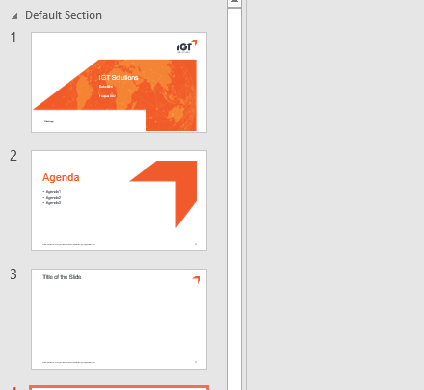
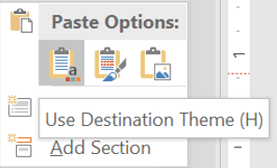
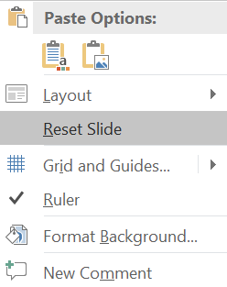
Use destination formatting while copy pasting slides from external PPT
If you copy slides from another PPT deck, always use “destination theme”. This allows the pasted slide to adopt the current PowerPoint theme
Tip: After using destination theme, right click on blank area and click “Reset Slide”. It makes sure that slide uses the exact placement of elements.

Slide 4
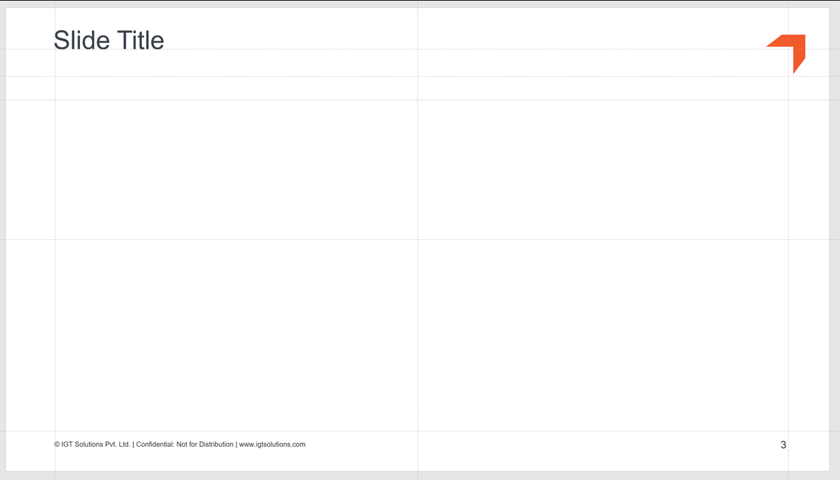
Headings, subheadings, and logos should show up in the same spot on each frame
Use the guides /grid for perfect placement of slide title and logo

Slide 5
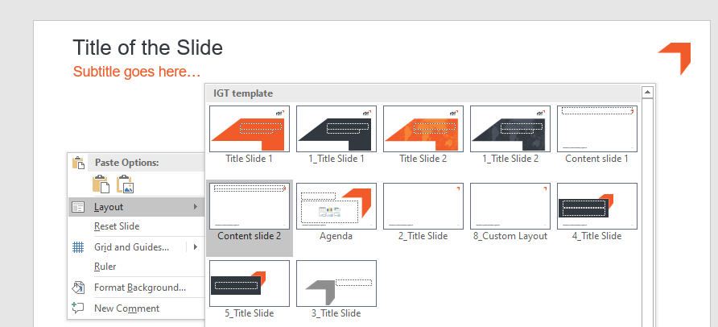
Choose the right master slide for the layout
Right click on the empty area of slide and choose the layout slide from the template that works
This will also ensure the right placements of elements as per the template

Slide 6
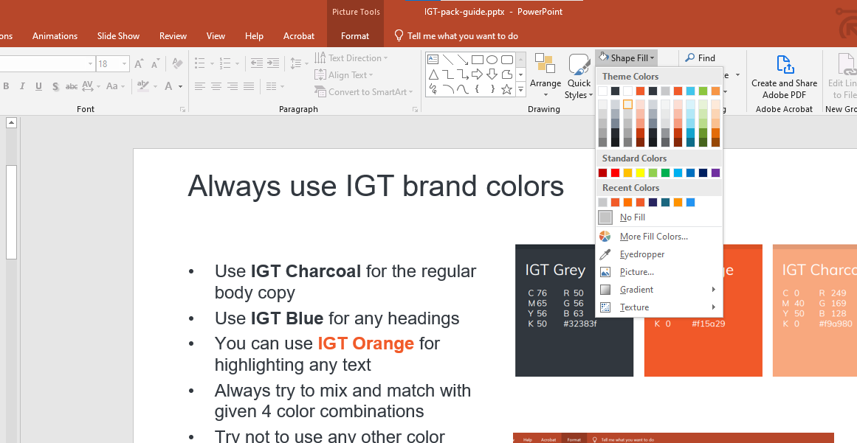
Always use IGT brand colors
Use IGT Charcoal for the regular body copy
Use IGT Blue for any headings
You can use IGT Orange for highlighting any text
Always try to mix and match with given 4 color combinations
Try not to use any other color
These brand colors are also given in the first line of color palette
Presence of these colors in color palette determines that you are using the right template

Slide 7
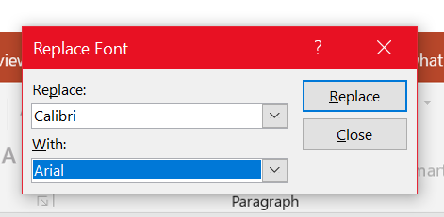
Fonts
We use “Arial” font for text in all PPTs
You can replace the existing font with Arial in all slides

Slide 8
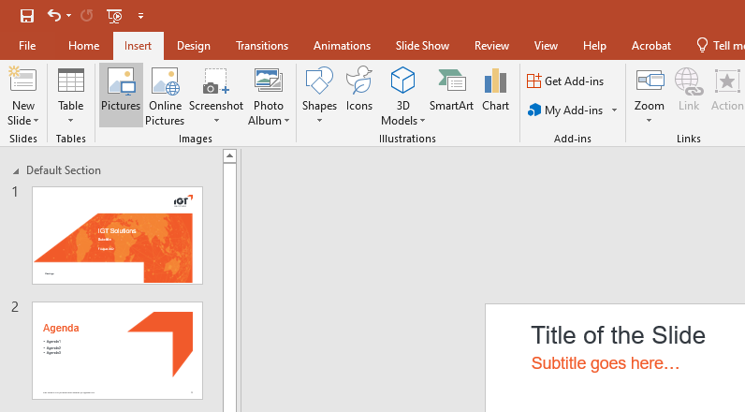
Usage of images
Only use purchased images in IGT presentations
Don’t just use the images from Google Images search. They are copyright protected with their respected owners. Google just provides the image as a search result.
However, you can use free icons, graphics and royalty free images from websites which clearly says “free usage” with no attribution required to the original creator
To use an image, click insert – Pictures – This Device – then browse the image and insert

Slide 9
Usage of images
To crop an image click format tab – Crop - crop
Always resize the image from corners to keep the image dimensions in same aspect ratio
Then click and drag any corner to crop it from that side.

Slide 10
Divider Slide

Slide 11
IGT Solutions Color Palette
IGT Grey
IGT Orange
IGT Orange Lite
IGT Silver
R 50
G 56
B 63
R 241
G 90
B 41
R 249
G 169
B 128
R199
G200
B202

Slide 12
Titles Are 30pt Regular, Title Case
Page Sub-heading:20pt Plain Text, Title Case. Resides On Page In This Position
This text should be 18 point plain, in this position on the page, sentence case highlight text in IGT Orange
This text should be 18 pt plain
This text should be 16 pt plain
This text should be 12 pt plain
This text should be 12 pt plain

Slide 13
Text-Table
 | Table title 12 Pt Bold Red Uppercase | Table title 12 Pt Bold Red Uppercase
12 pt bold gray right | 12 pt plain black text, sentence case 12 pt plain black text, sentence case | Table title 12 Pt Bold Red Uppercase
12 pt bold gray right | 12 pt plain black text, sentence case 12 pt plain black text, sentence case | Table title 12 Pt Bold Red Uppercase \
12 pt bold gray right | 12 pt plain black text, sentence case 12 pt plain black text, sentence case | Table title 12 Pt Bold Red Uppercase \
Font used in the tables should be either 12 or 10
When should it be 12 Low worded slide Slide would be used for a presentation | When should it be 10 Heavily worded slide Slide would not be presented but shared in print If at all used in a deck that would be presented, this slide would not be read through but used as a reference or as a supporting slide

Slide 14
Titles Are 30pt Regular, Title Case
Page Sub-heading:20pt Plain Text, Title Case. Resides On Page In This Position
12PT BOLD CAPS | 12PT BOLD CAPS | 12PT BOLD CAPS
12pt Bold | 12pt Bold | 12pt Plain
12pt Bold | 12pt Bold | 12pt Plain
12pt Bold | 12pt Bold | 12pt Plain
12pt Bold | 12pt Bold | 12pt Plain
12pt Bold | 12pt Bold | 12pt Plain
12pt Bold | 12pt Bold | 12pt Plain
12pt Bold | 12pt Bold | 12pt Plain
12pt Bold | 12pt Bold | 12pt Plain
12pt Bold | 12pt Bold | 12pt Plain

Slide 15
Titles Are 30pt Regular, Title Case
Page Sub-heading:20pt Plain Text, Title Case. Resides On Page In This Position
16 Pt Bold White Initial Cap
14pt plain text sentence case
14pt plain text sentence case
14pt plain text sentence case
16 Pt Bold White Initial Cap
14pt plain text sentence case
14pt plain text sentence case
14pt plain text sentence case
16 Pt Bold White Initial Cap
14pt plain text sentence case
14pt plain text sentence case
14pt plain text sentence case

Slide 16
Numbered Steps
1
16 pt bold text, sentence case
14 pt plain text, sentence case
6
16 pt bold text, sentence case
14 pt plain text, sentence case
2
16 pt bold text, sentence case
14 pt plain text, sentence case
7
16 pt bold text, sentence case
14 pt plain text, sentence case
3
16 pt bold text, sentence case
14 pt plain text, sentence case
8
16 pt bold text, sentence case
14 pt plain text, sentence case
4
16 pt bold text, sentence case
14 pt plain text, sentence case
9
16 pt bold text, sentence case
14 pt plain text, sentence case
5
16 pt bold text, sentence case
14 pt plain text, sentence case
10
16 pt bold text, sentence case
14 pt plain text, sentence case

Slide 17
Titles Are 30pt Regular, Title Case
Page Sub-heading:20pt Plain Text, Title Case. Resides On Page In This Position
12 PT UPPERCASE BOLD
12 pt plain sentence case 12 pt plain sentence case 12 pt plain sentence case 12 pt plain sentence case 12 pt plain sentence case 12 pt plain sentence case 12 pt plain sentence case
12 PT UPPERCASE BOLD
12 pt plain sentence case 12 pt plain sentence case 12 pt plain sentence case 12 pt plain sentence case 12 pt plain sentence case 12 pt plain sentence case 12 pt plain sentence case
12 PT UPPERCASE BOLD
12 pt plain sentence case 12 pt plain sentence case 12 pt plain sentence case 12 pt plain sentence case 12 pt plain sentence case 12 pt plain sentence case 12 pt plain sentence case

Slide 18
Number Matrix - 1
12 POINT BOLD UPPERCASE | TEXT | TEXT | TEXT
1. 12 pt Bold Initial Cap | XX | XX | XX
2. 12 pt Bold Initial Cap | XX | XX | XX
3. 12 pt Bold Initial Cap | XX | XX | XX
4. 12 pt Bold Initial Cap | XX | XX | XX
12 pt Bold Initial Cap | X | X | X

Slide 19
Number Matrix - 2
 | 12 POINT BOLD UPPERCASE | TEXT | TEXT | TEXT | TEXT
1. 12 pt Bold Initial Cap | 12 pt Plain Text, Initial Cap 12 pt Plain Text, Initial Cap | XX XX | XX XX | XX XX | XX XX
2. 12 pt Bold Initial Cap | 12 pt Plain Text, Initial Cap 12 pt Plain Text, Initial Cap | XX XX | XX XX | XX XX | XX XX
3. 12 pt Bold Initial Cap | 12 pt Plain Text, Initial Cap 12 pt Plain Text, Initial Cap | XX XX | XX XX | XX XX | XX XX
4. 12 pt Bold Initial Cap | 12 pt Plain Text, Initial Cap 12 pt Plain Text, Initial Cap | XX XX | XX XX | XX XX | XX XX
12 pt Bold Initial Cap | 12 pt Plain Text, Initial Cap | X | X | X | X

Slide 20
Number Matrix - 3
Cost – Benefit Analysis
CATEGORY | YEAR 0 | YEAR 1 | YEAR 2 | YEAR 3 | YEAR 4 | TOTAL
Benefits
10 pt Plain Text, Initial Cap | XX | XX | XX | XX | XX | XX
10 pt Plain Text, Initial Cap | XX | XX | XX | XX | XX | XX
10 pt Plain Text, Initial Cap | XX | XX | XX | XX | XX | XX
10 pt Plain Text, Initial Cap | XX | XX | XX | XX | XX | XX
10 pt Plain Text, Initial Cap | XX | XX | XX | XX | XX | XX
10 pt Plain Text, Initial Cap | XX | XX | XX | XX | XX | XX
Total | XX | XX | XX | XX | XX | XX
NPV of Benefits | XX
Costs
10 pt Plain Text, Initial Cap | XX | XX | XX | XX | XX | XX
10 pt Plain Text, Initial Cap | XX | XX | XX | XX | XX | XX
10 pt Plain Text, Initial Cap | XX | XX | XX | XX | XX | XX
10 pt Plain Text, Initial Cap | XX | XX | XX | XX | XX | XX
10 pt Plain Text, Initial Cap | XX | XX | XX | XX | XX | XX
10 pt Plain Text, Initial Cap | XX | XX | XX | XX | XX | XX
Total | XX | XX | XX | XX | XX | XX
Net Benefits | XX | XX | XX | XX | XX
NPV | XX
ROI | XX%

Slide 21
Simple Org Chart
Text in 16 pt bold
Text in 14 pt plain
Text in 14 pt plain
Text in 14 pt plain
Text in 14 pt plain
Text in 14 pt plain
Text
Text
Text

Slide 22
Event Schedule And Participation
Abcday, Month XX, YYYY
12pt Bold | 12pt Bold Initial Cap
3:00 PM – 4:00 PM | 12pt Initial Cap
12pt Plain (Time) | 12pt Initial Cap
12pt Plain | 12pt Initial Cap
12pt Plain | 12pt Initial Cap
12pt Plain | 12pt Initial Cap
12pt Plain | 12pt Initial Cap
12pt Plain | 12pt Initial Cap
12pt Plain | 12pt Initial Cap
12pt Plain | 12pt Initial Cap
12pt Plain | 12pt Initial Cap
12pt Plain | 12pt Initial Cap
12pt Plain | 12pt Initial Cap
12pt Plain | 12pt Initial Cap
12pt Plain | 12pt Initial Cap

Slide 23
Event Schedule And Participation – Details
Abcday, Month XX, YYYY
12pt Bold (Time) | 12pt Bold Initial Cap
 | 12pt Initial Cap | 12pt Initial Cap
 | 12pt Initial Cap | 12pt Initial Cap
11:00 AM – 1:00 PM | 12pt Bold Initial Cap
 | 12pt Initial Cap | 12pt Initial Cap
 | 12pt Initial Cap | 12pt Initial Cap
12pt Bold (Time) | 12pt Bold Initial Cap
 | 12pt Initial Cap | 12pt Initial Cap
 | 12pt Initial Cap | 12pt Initial Cap
12pt Bold (Time) | 12pt Bold Initial Cap
 | 12pt Initial Cap | 12pt Initial Cap
 | 12pt Initial Cap | 12pt Initial Cap

Slide 24
Timeline
Activities | Pre-Work | Project Week
 |  | Week 1 | Week 2 | Week 3 | Week 4 | Week 5
12pt Initial Cap
12pt Initial Cap
12pt Initial Cap
12pt Initial Cap
12pt Initial Cap
12pt Initial Cap
12pt Initial Cap
12pt Initial Cap
12pt Initial Cap
12pt Initial Cap
12pt Initial Cap
12pt Initial Cap
10pt Bold
10pt Bold
10pt Bold
10pt Bold
10pt Bold

Slide 25
Analyst/Customer Quotes
 | “Quote in 14 pt Arial plain, sentence case within quotations. Quote in 14 pt Arial plain, sentence case within quotations. Quote in 14 pt Arial plain, sentence case within quotations.” Name in 12 pt arial bold text, Title in 12 pt plain text
 | “Quote in 14 pt Arial plain, sentence case within quotations. Quote in 14 pt Arial plain, sentence case within quotations. Quote in 14 pt Arial plain, sentence case within quotations.” Name in 12 pt arial bold text, Title in 12 pt plain text
 | “Quote in 14 pt Arial plain, sentence case within quotations. Quote in 14 pt Arial plain, sentence case within quotations. Quote in 14 pt Arial plain, sentence case within quotations.” Name in 12 pt arial bold text, Title in 12 pt plain text
 | “Quote in 14 pt Arial plain, sentence case within quotations. Quote in 14 pt Arial plain, sentence case within quotations. Quote in 14 pt Arial plain, sentence case within quotations.” Name in 12 pt arial bold text, Title in 12 pt plain text

Slide 26
Section Break
Sub-title

Slide 27
Financial Analysis, Charts and Graphs

Slide 28
Trend Providing A Fact Based Perspective Or Trend Implications
12pt Bold
U.S. $Billions
Key Highlights:
ABC
ABC

Slide 29
Trend Providing A Fact Based Perspective Or Trend Implications
12pt Bold
U.S. $Billions
Key Highlights:
ABC
ABC

Slide 30
Trend Providing A Fact Based Perspective Or Trend Implications
12pt Bold
U.S. $Billions
Key Highlights:
ABC
ABC

Slide 31
Bar Chart
12pt Bold
U.S. $Billions
Key Highlights:
ABC
ABC

Slide 32
Two Charts
12pt Bold
U.S. $Billions

Slide 33
Venn 1
16 pt plain text sentence case
16 pt plain text sentence case
16 pt bold text sentence case
16 pt bold text sentence case
Text
16 pt bold text sentence case
16 pt plain text sentence case

Slide 34
Chevrons Horizontal
Text
Text
Text
Text
Text
Text
Text
Text
Text
Text
Text
Text
Text
Text
Text
Text
Text
Text

Slide 35
Thank You

